Slide 1



Green University of Bangladesh
Dept. of Computer Science and Engineering
Fall - 2024, Section- 221-D1
Course Title: Computer Networking Lab
Course Code: CSE-312
Presented By:
Name | ID
Maruf Hossain | 221902318
Moharof Hossen Parvez | 221002116

Slide 2
IoT Smart Home Using Cisco
2
Presentation on

Slide 3

CONTENT
01
Introduction
02
Motivation
03
Design Goals & Objectives
04
Application
05
Tools
06
Features
07
Interface
08
Limitations
09
Scope of Future Work
10
Conclusion

Slide 4




INTRODUCTION
What is Smart Home?

Slide 5



MOTIVATION
Smart & Energy Efficient Home
Reduce Power Consumption
Security
Simplified Daily Tasks

Slide 6





GOALS AND OBJECTIVES
Automation
Security
Energy Efficiency
01
02
03

Slide 7


APPLICATION
01
02
03
04
Healthcare Sector
Educational Institutions
Smart City
Residential
Homes

Slide 8


TOOLS

Slide 9




FEATURES
Remote Control
with Smartphone
Real-time
Surveillance
Lighting Automation
Managing Overall House Area

Slide 10
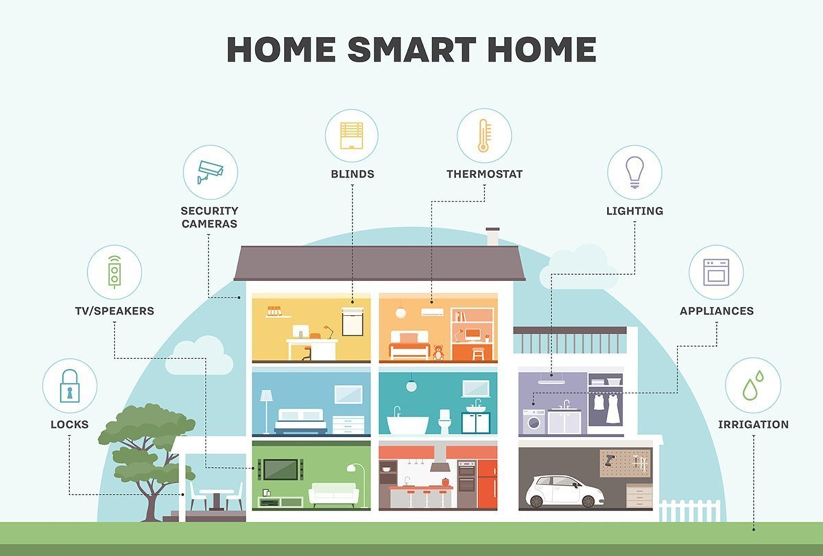
SCENARIOS:

Slide 11
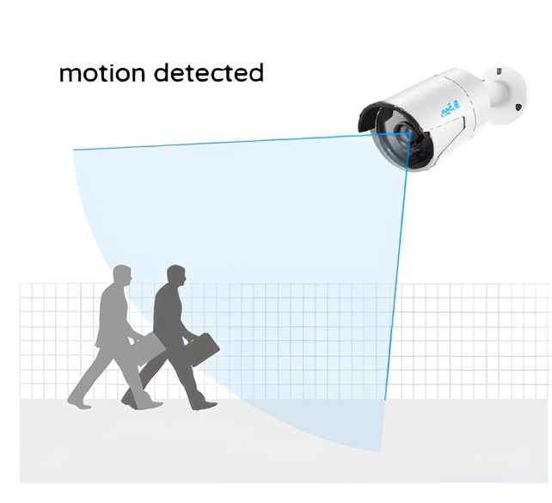

SCENARIOS:

Slide 12



SCENARIOS:

Slide 13
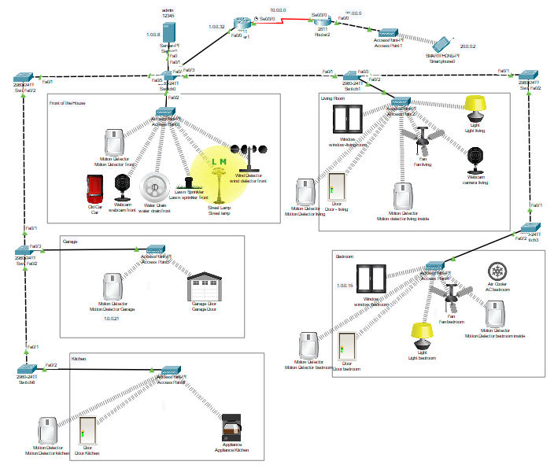
INTERFACE:

Slide 14
LIMITATIONS
High Initial Setup Costs
Network Latency
Power Dependency
Security Risks

Slide 15
SCOPE OF FUTURE WORK
Cost Reduction
Better Optimization
03
01
02
Advanced Security Algorithm
Voice and AI-based Control
Additional
Devices
04
05
06
Reduce
Network Latency

Slide 16


CONCLUSION

Slide 17



